Slide 1

Chapter 4:
Cluster Analysis in Data Mining
Notes:
‹#›

Slide 2
Methods for Clustering Validation
Objective
Understand the importance of clustering validation.
Explore evaluation measures for measuring clustering quality.
Learn about constraint-based clustering and its role in validation.
Discover external measures for comparing clustering results to ground truth.
Recognize internal measures for evaluating clustering without external validation.
Gain insights into cluster stability and clustering tendency.
Let's delve into the world of clustering validation and how it contributes to robust analysis.
‹#›

Slide 3
Methods for Clustering Validation
Clustering Validation Importance
Clustering validation is crucial to ensure the reliability and meaningfulness of clustering outcomes.
Why Validate Clustering?
  Objective Assessment: Evaluate if clusters reflect true underlying patterns.
  Comparison: Compare different clustering algorithms or parameter settings.
  Insight Interpretation: Support meaningful interpretation of cluster results.
Validating clustering results prevents misleading interpretations and enhances data-driven decision-making.
‹#›

Slide 4
Methods for Clustering Validation
Clustering Validation and Assessment
Major issues on clustering validation and assessment
  Clustering evaluation
    Evaluating the goodness of the clustering
  Clustering stability
    To understand the sensitivity of the clustering result to various algorithm parameters, e.g., # of clusters
  Clustering tendency
    Assess the suitability of clustering, i.e., whether the data has any inherent grouping structure
‹#›

Slide 5
Methods for Clustering Validation
Measuring Clustering Quality
Clustering Evaluation: Evaluating the goodness of clustering results
  No commonly recognized best suitable measure in practice
  Three categorization of measures: External, internal, and relative
    External: Supervised, employ criteria not inherent to the dataset
    Internal: Unsupervised, criteria derived from data itself
    Relative: Directly compare different clusterings, usually those obtained via different parameter settings for the same algorithm
‹#›

Slide 6
Methods for Clustering Validation
Measuring Clustering Quality: External Methods
Given the ground truth T, Q(C, T) is the quality measure for a clustering C
Q(C, T) is good if it satisfies the following four essential criteria
  Cluster homogeneity - The purer, the better
  Cluster completeness - Assign objects belonging to the same category in the ground truth to the same cluster
Rag bag better than alien - Putting a heterogeneous object into a pure cluster should be penalized more than putting it into a rag bag (i.e., “miscellaneous” or “other” category)
Small cluster preservation - Splitting a small category into pieces is more harmful than splitting a large category into pieces
‹#›

Slide 7


Methods for Clustering Validation
External Measures I: Matching-Based Measures
Matching-Based Measures (I): Purity vs. Maximum Matching
Purity: Quantifies the extent that cluster Ci contains points only from one (ground truth) partition:
  Total purity of clustering C:
  Perfect clustering if purity = 1 and r = k (the number of clusters obtained is the same as that in the ground truth)
  Ex. 1 (green or orange): purity1 = 30/50; purity2 = 20/25; purity3 = 25/25; purity = (30 + 20 + 25)/100 = 0.75
  Two clusters may share the same majority partition
‹#›

Slide 8
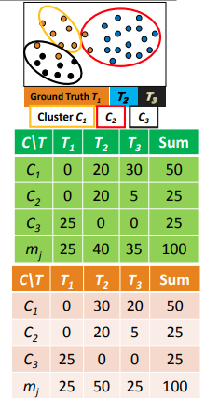
Methods for Clustering Validation
External Measures I: Matching-Based Measures
Maximum matching: Only one cluster can match one partition
  Match: Pairwise matching, weight w(eij) = nij
  Maximum weight matching:
  Ex2. (green) match = purity = 0.75; (orange) match = 0.65 > 0.6
‹#›

Slide 9


Methods for Clustering Validation
Matching-Based Measures (II): F-Measure
Precision: The fraction of points in Ci from the majority partition (i.e., the same as purity), where j i is the partition that contains the maximum # of points from Ci
  Ex. For the green table
    prec1 = 30/50; prec2 = 20/25; prec3 = 25/25
  Recall: The fraction of point in partition shared in common with cluster Ci , where
    Ex. For the green table
      recall1 = 30/35; recall2 = 20/40;
      recall3 = 25/25
‹#›

Slide 10
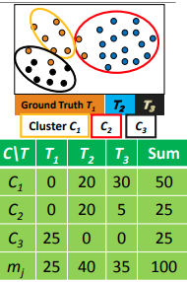


Methods for Clustering Validation
Matching-Based Measures (II): F-Measure
PF-measure for Ci :
  The harmonic means of preci and recalli :
  F-measure for clustering C: average of all clusters:
    Ex. For the green table
      F1 = 60/85; F2 = 40/65; F3 = 1; F = 0.774
‹#›

Slide 11
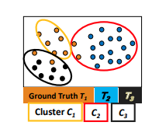


Methods for Clustering Validation
External Measures II: Entropy-Based Measures
Entropy of clustering C:
Entropy of partitioning T:
Entropy of T with respect to cluster Ci :
‹#›

Slide 12

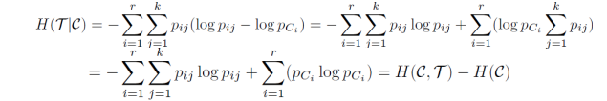
Methods for Clustering Validation
External Measures II: Entropy-Based Measures
Conditional entropy of T with respect to clustering C:
  The more a cluster’s members are split into different partitions, the higher the conditional entropy
  For a perfect clustering, the conditional entropy value is 0, where the worst possible conditional entropy value is log k
‹#›

Slide 13

Methods for Clustering Validation
Entropy-Based Measures (II): Normalized Mutual Information (NMI)
Mutual information:
  Quantifies the amount of shared info between the clustering C and partitioning T
  Measures the dependency between the observed joint probability pij of C and T, and the expected joint probability pCi . pTj under the independence assumption
  When C and T are independent, pij = pCi . pTj, I(C, T) = 0. However, there is no upper bound on the mutual information
‹#›

Slide 14

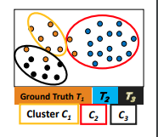
Methods for Clustering Validation
Entropy-Based Measures (II): Normalized Mutual Information (NMI)
Normalized mutual information (NMI)
  Value range of NMI: [0,1]. Value close to 1 indicates a good clustering
‹#›

Slide 15


Methods for Clustering Validation
Internal Measures (I): BetaCV Measure
A trade-off in maximizing intra-cluster compactness and inter-cluster separation
Given a clustering C = {C1, . . ., Ck} with k clusters, cluster Ci containing ni = |Ci | points
  Let W(S, R) be sum of weights on all edges with one vertex in S and the other in R
  The sum of all the intra-cluster weights over all clusters:
  The sum of all the inter-cluster weights:
‹#›

Slide 16
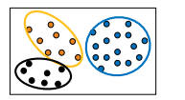



Methods for Clustering Validation
Internal Measures (I): BetaCV Measure
The number of distinct intra-cluster edges:
The number of distinct inter-cluster edges:
Beta-CV measure:
  The ratio of the mean intra-cluster distance to the mean inter-cluster distance
  The smaller, the better the clustering
‹#›

Slide 17


Methods for Clustering Validation
Internal Measures (II): Normalized Cut and Modularity
Normalized cut:
where vol(Ci ) = W(Ci , V) is the volume of cluster Ci
  The higher normalized cut value, the better the clustering
Modularity (for graph clustering)
  Modularity Q is defined as
  Modularity measures the difference between the observed and expected fraction of weights on edges within the clusters.
  The smaller the value, the better the clustering—the intra-cluster distances are lower than expected
‹#›

Slide 18




Methods for Clustering Validation
Relative Measures
Relative measure: Directly compare different clusterings, usually those obtained via different parameter settings for the same algorithm
Silhouette coefficient as an internal measure: Check cluster cohesion and separation
  For each point xi , its silhouette coefficient si is:
  where is the mean distance from xi to points in its own cluster
  is the mean distance from xi to points in its closest cluster
  Silhouette coefficient (SC) is the mean values of si across all the points:
  SC close to +1 implies good clustering
    Points are close to their own clusters but far from other clusters
‹#›

Slide 19

Methods for Clustering Validation
Relative Measures
Silhouette coefficient as a relative measure: Estimate the # of clusters in the data
  Pick the k value that yields the best clustering, i.e., yielding high values for SC and SCi (1 ≤ i ≤ k)
‹#›

Slide 20
Methods for Clustering Validation
Cluster Stability
Clusterings obtained from several datasets sampled from the same underlying distribution as D should be similar or “stable”
Typical approach:
  Find good parameter values for a given clustering algorithm
  Example: Find a good value of k, the correct number of clusters
‹#›

Slide 21
Methods for Clustering Validation
Cluster Stability
  A bootstrapping approach to find the best value of k (judged on stability)
    Generate t samples of size n by sampling from D with replacement
    For each sample Di , run the same clustering algorithm with k values from 2 to kmax
    Compare the distance between all pairs of clusterings Ck(Di ) and Ck(Dj ) via some distance function
      Compute the expected pairwise distance for each value of k
    The value k* that exhibits the least deviation between the clusterings obtained from the resampled datasets is the best choice for k since it exhibits the most stability
‹#›

Slide 22
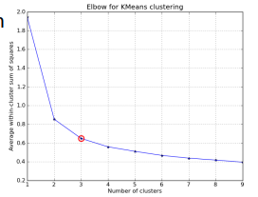
Methods for Clustering Validation
Other Methods for Finding K, the Number of Clusters
Empirical method # of clusters: for a dataset of n points (e.g., n = 200, k = 10)
Elbow method: Use the turning point in the curve of the sum of within cluster variance with respect to the # of clusters
‹#›

Slide 23
Methods for Clustering Validation
Other Methods for Finding K, the Number of Clusters
Cross validation method
  Divide a given data set into m parts
  Use m – 1 parts to obtain a clustering model
  Use the remaining part to test the quality of the clustering
    For example, for each point in the test set, find the closest centroid, and use the sum of squared distance between all points in the test set and the closest centroids to measure how well the model fits the test set
  For any k > 0, repeat it m times, compare the overall quality measure w.r.t. different k’s, and find # of clusters that fits the data the best
‹#›

Slide 24
Methods for Clustering Validation
Clustering Tendency: Whether the Data Contains Inherent Grouping Structure
Assessing the suitability of clustering (i.e., whether the data has any inherent grouping structure)
Determining clustering tendency or clusterability
  A hard task because there are so many different definitions of clusters E.g., partitioning, hierarchical, density-based, graph-based, etc.
  Even fixing cluster type, still hard to define an appropriate null model for a data set
‹#›

Slide 25
Methods for Clustering Validation
Clustering Tendency: Whether the Data Contains Inherent Grouping Structure
Still, there are some clusterability assessment methods, such as
  Spatial histogram: Contrast the histogram of the data with that generated from random samples
  Distance distribution: Compare the pairwise point distance from the data with those from the randomly generated samples
  Hopkins Statistic: A sparse sampling test for spatial randomness
‹#›

Slide 26
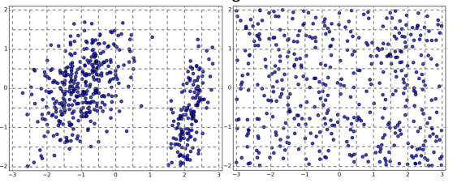
Methods for Clustering Validation
Testing Clustering Tendency: A Spatial Histogram Approach
Spatial Histogram Approach: Contrast the d-dimensional histogram of the input dataset D with the histogram generated from random samples
  Dataset D is clusterable if the distributions of two histograms are rather different
‹#›

Slide 27
Methods for Clustering Validation
Testing Clustering Tendency: A Spatial Histogram Approach
Method outline
  Divide each dimension into equi-width bins, count how many points lie in each cells, and obtain the empirical joint probability mass function (EPMF)
  Do the same for the randomly sampled data
  Compute how much they differ using the Kullback-Leibler (KL) divergence value
‹#›

Slide 28
Methods for Clustering Validation
Application: Customer Segmentation
Let's apply clustering validation techniques to customer segmentation.
Objective:
  Identify meaningful customer segments for targeted marketing.
Steps:
  Data Collection: Gather customer attributes and behaviors.
  Clustering: Apply clustering algorithms to create segments.
  Validation: Evaluate clustering quality using external and internal measures.
  Segment Profiling: Interpret and analyze formed segments.
  Clustering validation ensures accurate and actionable customer segments for effective marketing strategies.
‹#›

Slide 29
Methods for Clustering Validation
Considerations and Challenges
Clustering validation comes with considerations and challenges.
Considerations:
  Choose appropriate measures based on data characteristics and analysis goals.
  Combine multiple measures for a comprehensive evaluation.
Challenges:
  Lack of ground truth or reference clustering.
  Sensitivity to parameter choices.
  Understanding these considerations and challenges enhances the reliability of clustering validation.
‹#›

Slide 30
Methods for Clustering Validation
Course Conclusion
Introduction to Cluster Analysis: Concepts, applications, and challenges.
Similarity Measures: Various metrics for measuring similarity.
Partitioning-Based Clustering: K-Means, K-Medoids, and more.
Hierarchical Clustering: Agglomerative, divisive, and advanced methods.
Density-Based and Grid-Based Clustering: DBSCAN, OPTICS, STING, and CLIQUE.
Clustering Validation: External and internal measures, stability, and clustering tendency.
Congratulations on completing this course! You now possess the knowledge and tools to analyze complex datasets and uncover valuable insights through cluster analysis.
‹#›

Slide 31
Summary
Clustering Validation Methods
Importance and evaluation measures.
Constraint-based clustering.
External and internal measures.
Cluster stability and tendency.
‹#›

